Slide 1

Automating Receipt Data Entry
Streamlining the manual process of extracting and entering data from food and petrol bill receipts can significantly improve efficiency and reduce workload for the finance team.
1

Slide 2

Connecting to Email Inbox
1
Email Retrieval
Automatically fetch emails containing receipt attachments from a specified inbox, such as Gmail.
2
Attachment Download
Download the attached receipts in PDF or image format for further processing.
3
Parsing Email Content
Extract key details from the email, like sender information and any additional notes.
2

Slide 3
Extracting Receipt Details
Receipt Date
Receipt Number
Vendor Name
Identify the date the receipt was issued, which is crucial for financial tracking and reporting.
Capture the unique receipt number for easy reference and reconciliation.
Extract the name of the vendor or merchant where the purchase was made.
3

Slide 4
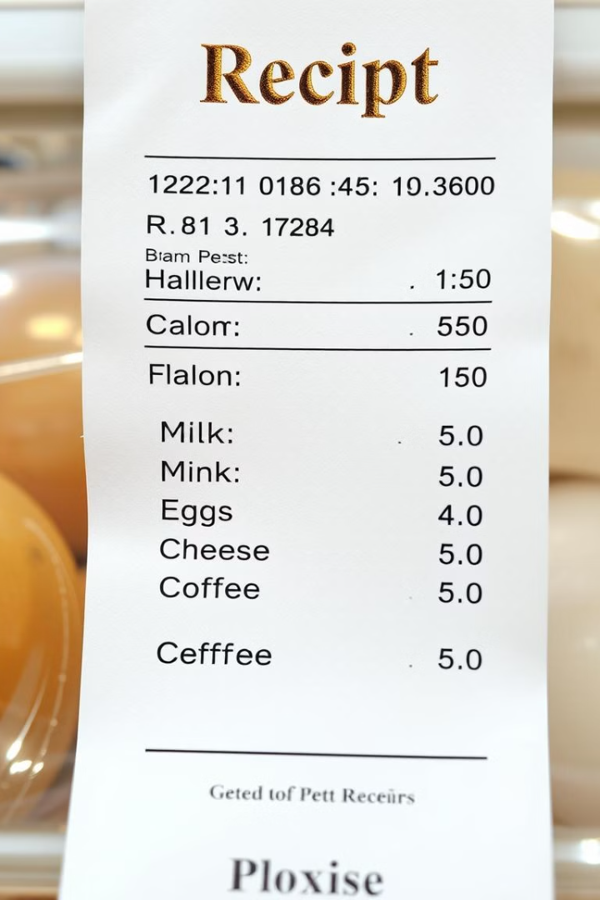
Capturing Purchase Details
Total Amount
Accurately record the total amount charged on the receipt for accounting purposes.
Items Purchased
For food bills, extract the list of items purchased to provide more detailed information.
Fuel Purchases
For petrol bills, capture the quantity of fuel and the cost per unit.
4

Slide 5
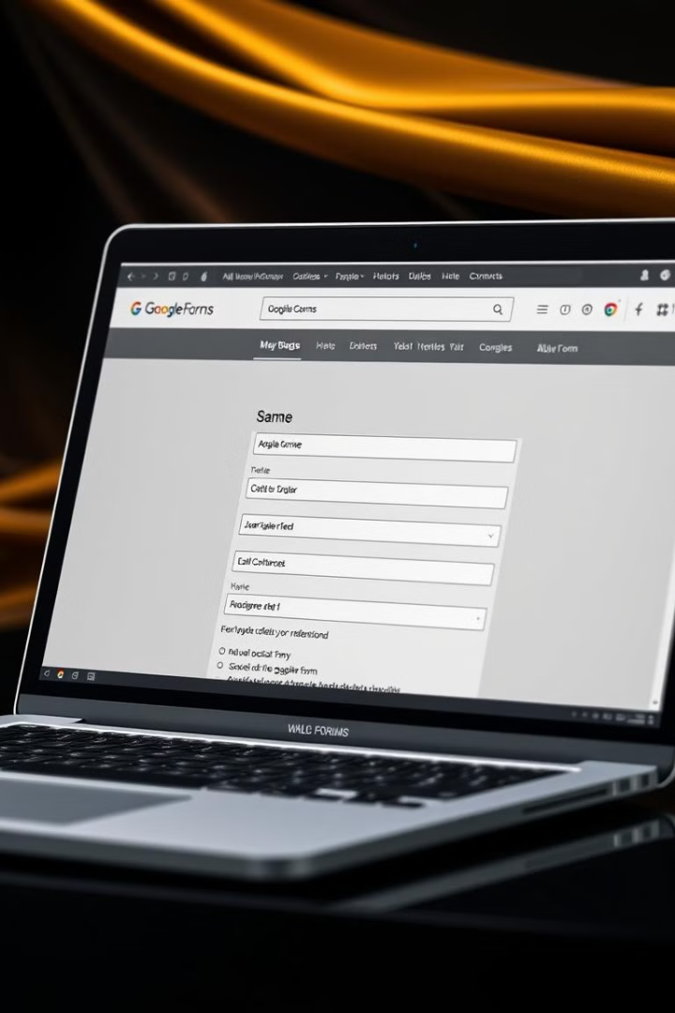
Integrating with Google Forms
1
Form Integration
Automatically populate a Google Form with the extracted receipt details for easy data entry.
2
Data Storage
The Google Form responses can be stored in a spreadsheet for further analysis and reporting.
3
Workflow Automation
Streamline the entire process, from fetching emails to updating the Google Form.
5

Slide 6
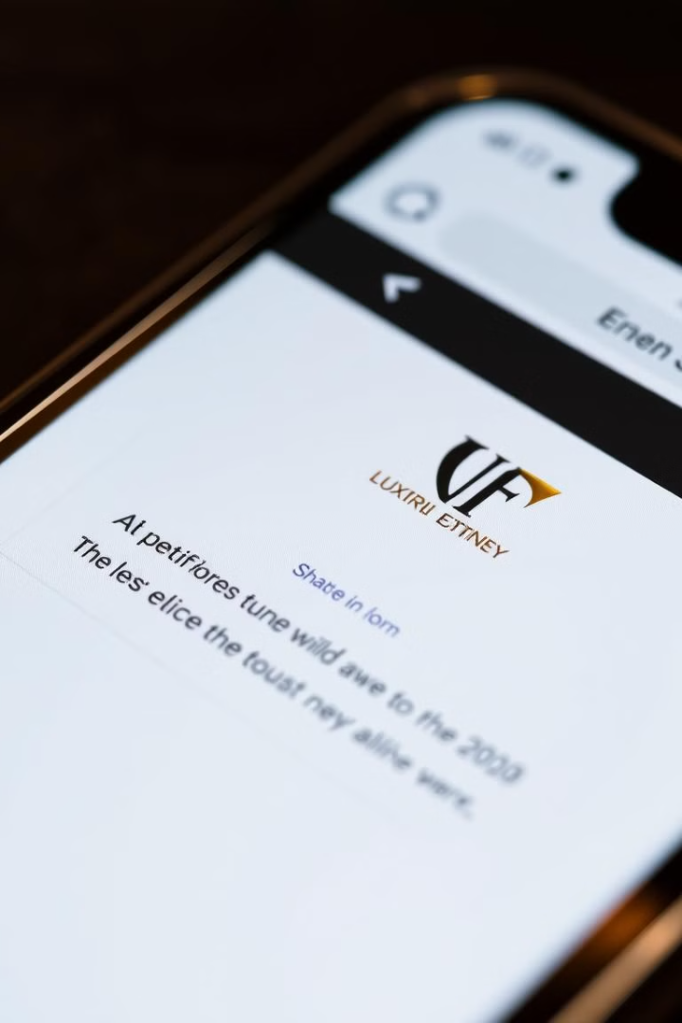



Notification to Finance Team
Email Notification
Automatically send a summary email to the finance team with key receipt details.
Receipt Details
Include the total amount, vendor name, and any other relevant information.
Timely Updates
Provide the finance team with real-time information on the processed receipts.
6

Slide 7




Handling Exceptions
Receipt Validation
Manual Review
Feedback Loop
Implement checks to identify any incomplete or invalid receipt data.
Flag problematic receipts for manual review and intervention by the finance team.
Continuously improve the automation by incorporating learnings from exceptions.
7

Slide 8
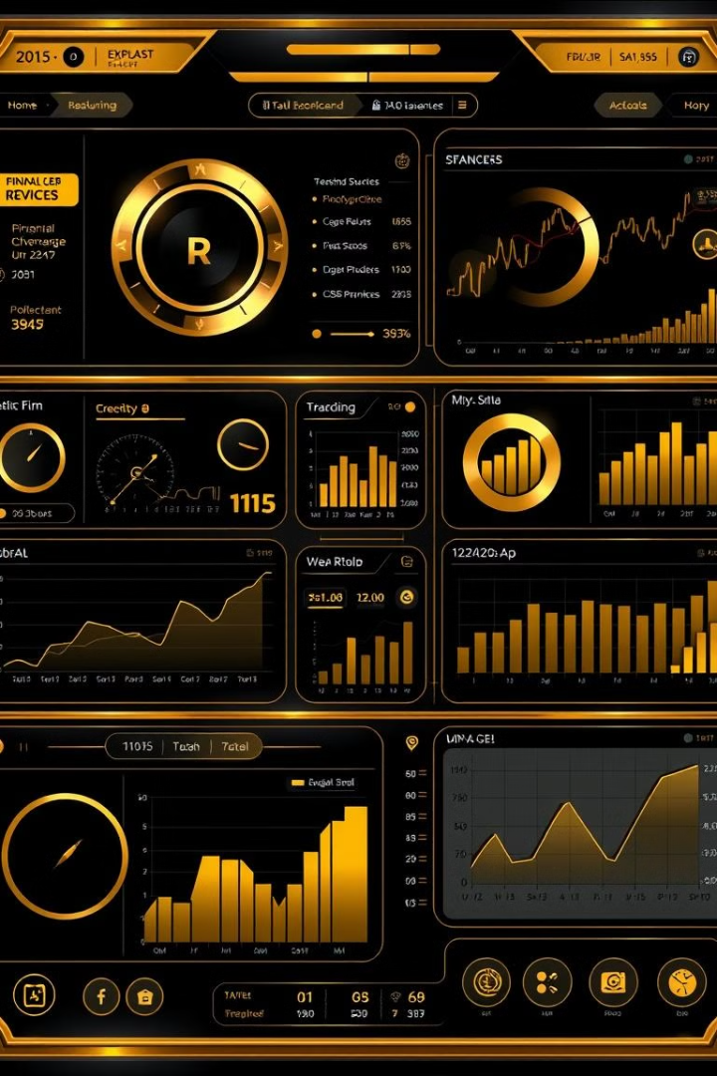
Reporting and Analytics
Vendor Insights
Track spending patterns and identify top vendors.
Expense Trends
Analyze changes in expenses over time for better budgeting.
Anomaly Detection
Identify unusual or suspicious transactions for further investigation.
8

Slide 9
Continuous Improvement
Feedback and Refinement
Expanding Capabilities
Scalability and Performance
Explore opportunities to expand the automation to handle additional receipt types or integrate with other systems.
Regularly gather feedback from the finance team to enhance the automation's effectiveness.
Ensure the automation can handle increasing volumes of receipts without compromising speed and accuracy.
9

